Slide 1

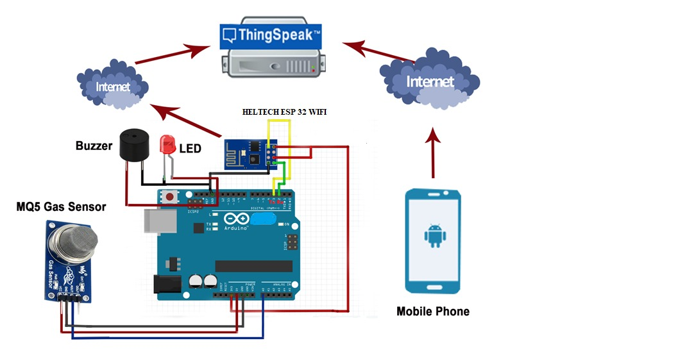
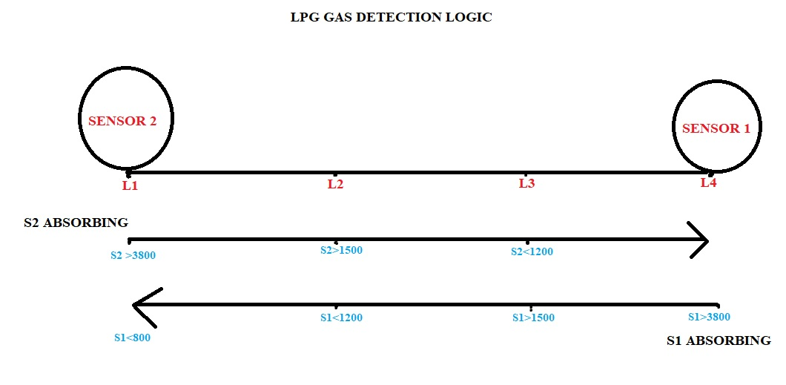


IOT- Pipeline Leak Detection and Realtime in LPG Industry.
Your Names here
Advisor: Dr. Sejun Song, University of Missouri – Kansas City
MOTIVATION:
The aim of this paper is to monitor and detect the gas leakage. The sensor is fixed in the pipeline used to detect gas leakage. During working in the industries if the gas leakage is sensed the lcd monitor displays a alert message and gives an alarm alert. If the gas leakage is found during the absence of peoples in place of incident, sensor sense the leakage and sends the alert message to the user mobile through an application. The status of gas leakage is fed into the controller, using wi-fi connection the wi-fi module sends the alert message to the cloud and it is redirected to the application over the internet.
MOTIVATION:
CURRENT PROBLEMS:
WORKING OF PROTOTYPE:
In the current method, gas sensing technology is used. The Pipeline leakage is detected by the semiconductor sensor. The leakage of gas may happen due to the human error, false chemical reaction, lack of service done in the gas valve.
We have used a ESP8266 WIFI Module which is built with 32KB instruction, 80KB user data of Memory and with 80MHz Clock speed (default) and also with consisting pins of total 17 GPIO pins.
MQ-5 Gas sensor we have used in this prototype with specs of Analog & Digital Interface, with 5V power supply, with consumption current of 150mA, the sensor have a high sensitivity to detect butane, propane, methane and also can detect methane and propane at the same time.
In a website application we can monitor the real-time and can predict the leakage in the moment of time itself.
The website application collects all 2 distances from 2 different sensors and does get the alert in real-time with a buzzer bipping on it.
After finding the position on website application with exact point and location on Pipeline we can prevent the problem.
OUR SOLUTION:
The system consists of 2 MQ5 gas sensors, with ESP8266 WIFI Module, Buzzer. As soon as the gas leakage is detected in pipeline, the ESP Module sends an alert to mobile app and the user can access through smartphone.
The MQ5 sensors are located in such a way to detect the leakage in between them the sensors
There is a method for detecting and notifying Pipeline leaks. When a Pipeline leak is discovered, this system sounds the alarm and displays the severity of the leak to alert others. The method is really straight forward but reliable. The Internet of Things is the foundation for the gas detector's design. The data will be recorded and uploaded into an information cloud by the gas detector sensor employed in the design.
The sensor will detect a gas leak and use a buzzer to sound an alert if it occurs. An LCD screen is used to show the leak, alert the viewer, and start the exhaust fan in the specific location or segment where the leak is occurring so that the gas may be extracted.
CONCLUSION
Successfully, we are able to show the accurate position of the device in indoors as well as outdoors.
For future situations we can prevent the other problems with other sensors as well.
GitHub link & barcode
Youtube link

